Slide 1
FITNESS BUDDY
IBM AICTE PROJECT
Presented By:
Student name : V Deepak
College Name & Department : Computer Science and Engineering, NSS College of Engineering, Palakkad, Kerala

Slide 2
OUTLINE
Problem Statement
Technology used
Wow factor
End users
Result
Conclusion
Git-hub Link
Future scope
IBM Certifications

Slide 3
PROBLEM STATEMENT
Many people struggle to maintain a healthy lifestyle due to:
Lack of personalized fitness advice
Time constraints & low motivation
Rigid or expensive fitness plans
Limited access to adaptable home routines
Proposed Solution – Fitness Buddy A conversational Agentic AI assistant powered by IBM Granite, offering:
Tailored home workout plans
Quick, healthy meal suggestions
Daily motivation & habit-building tips
anytime/anywhere.

Slide 4
TECHNOLOGY USED
IBM Cloud lite services
Natural Language Processing (NLP)
IBM Granite model

Slide 5
IBM CLOUD SERVICES USED
IBM Cloud WatsonX AI Studio
IBM Cloud WatsonX AI runtime
IBM Cloud Agent Lab
IBM Granite foundation model

Slide 6
WOW FACTORS
Agentic AI Integration Utilizes IBM’s Granite large language model to simulate an intelligent, goal-driven virtual fitness coach capable of dynamic, context-aware interactions.
Personalized Wellness Guidance Delivers tailored home workout routines, nutritional suggestions, and motivational coaching based on individual user inputs and preferences.
Conversational User Experience Implements a natural-language chat interface, enhancing usability and making health guidance more accessible and engaging for all users.
Cloud-Native & Serverless Architecture Deployed using IBM Cloud Functions, ensuring scalability, zero server maintenance, and real-time availability without infrastructure overhead.
Modular & Extensible Design Built with future integrations in mind—can be extended to include habit tracking, user progress monitoring, reminders, and wearable sync.
Efficient Use of IBM Watsonx.ai Demonstrates optimal prompt engineering within WatsonX.ai to simulate distinct expert roles (trainer, nutritionist, motivator) in a unified assistant.
Inclusive and Practical Application Addresses a real-world need by providing an accessible, low-cost, and adaptive fitness solution for users with time, space, or resource limitations.

Slide 7
END USERS
Students and Young Professionals
Remote Workers and Freelancers
Health-Conscious Beginners
Budget-Constrained Users
General Public Seeking Home-Based Wellness

Slide 8
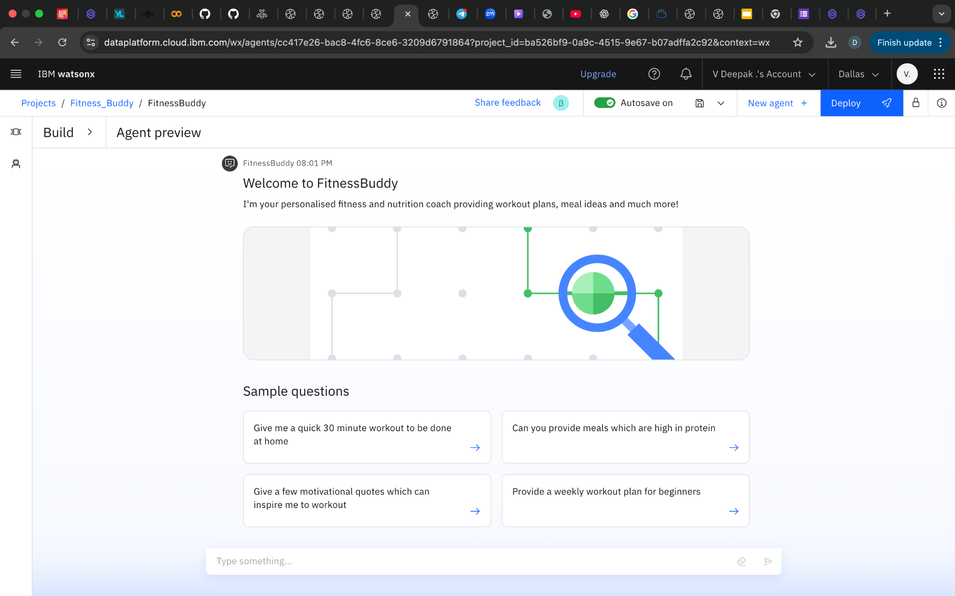
RESULTS

Slide 9
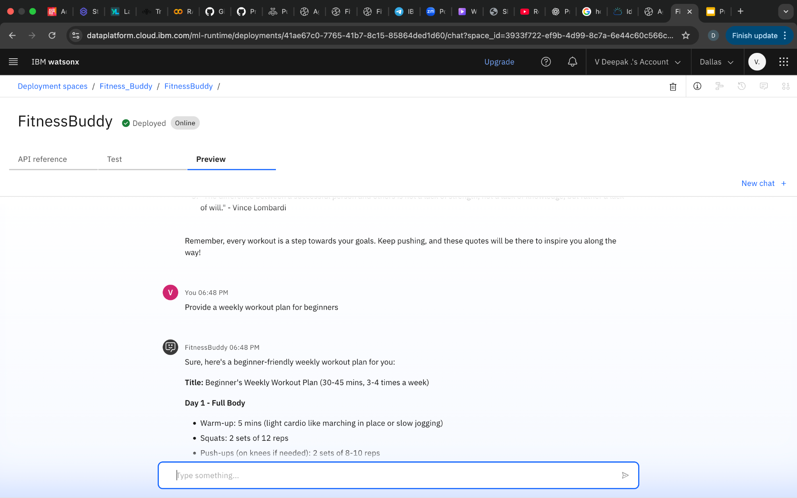
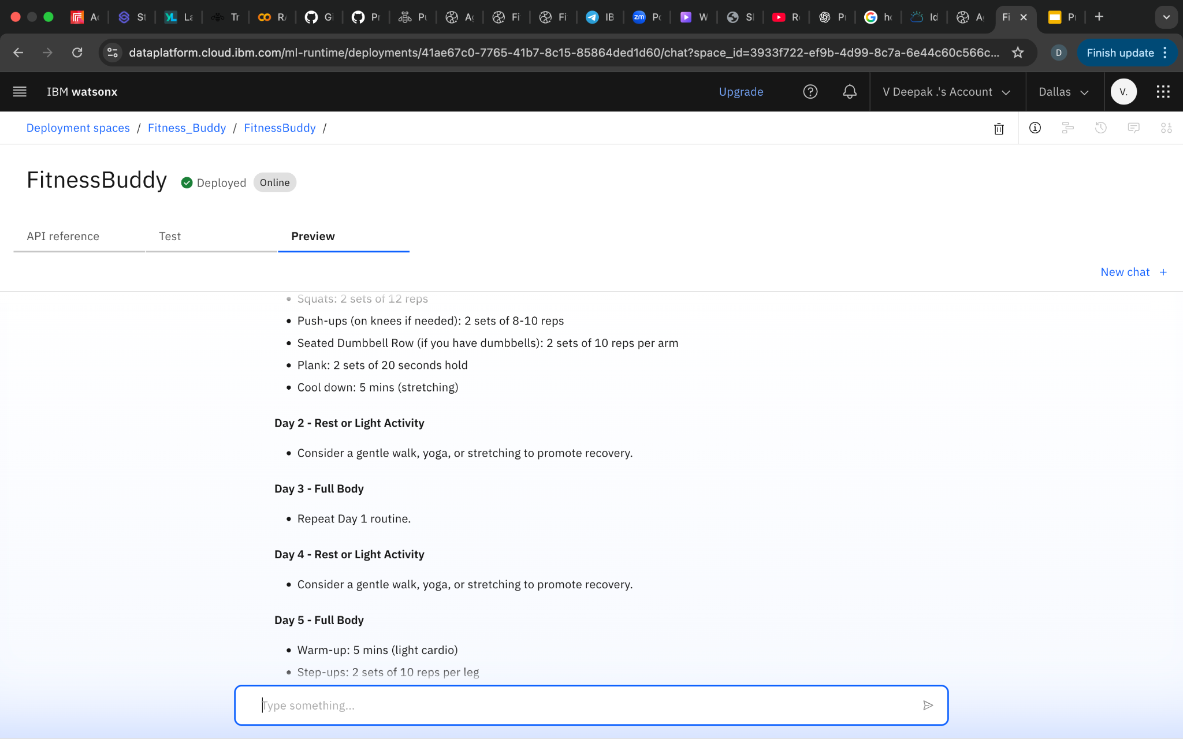
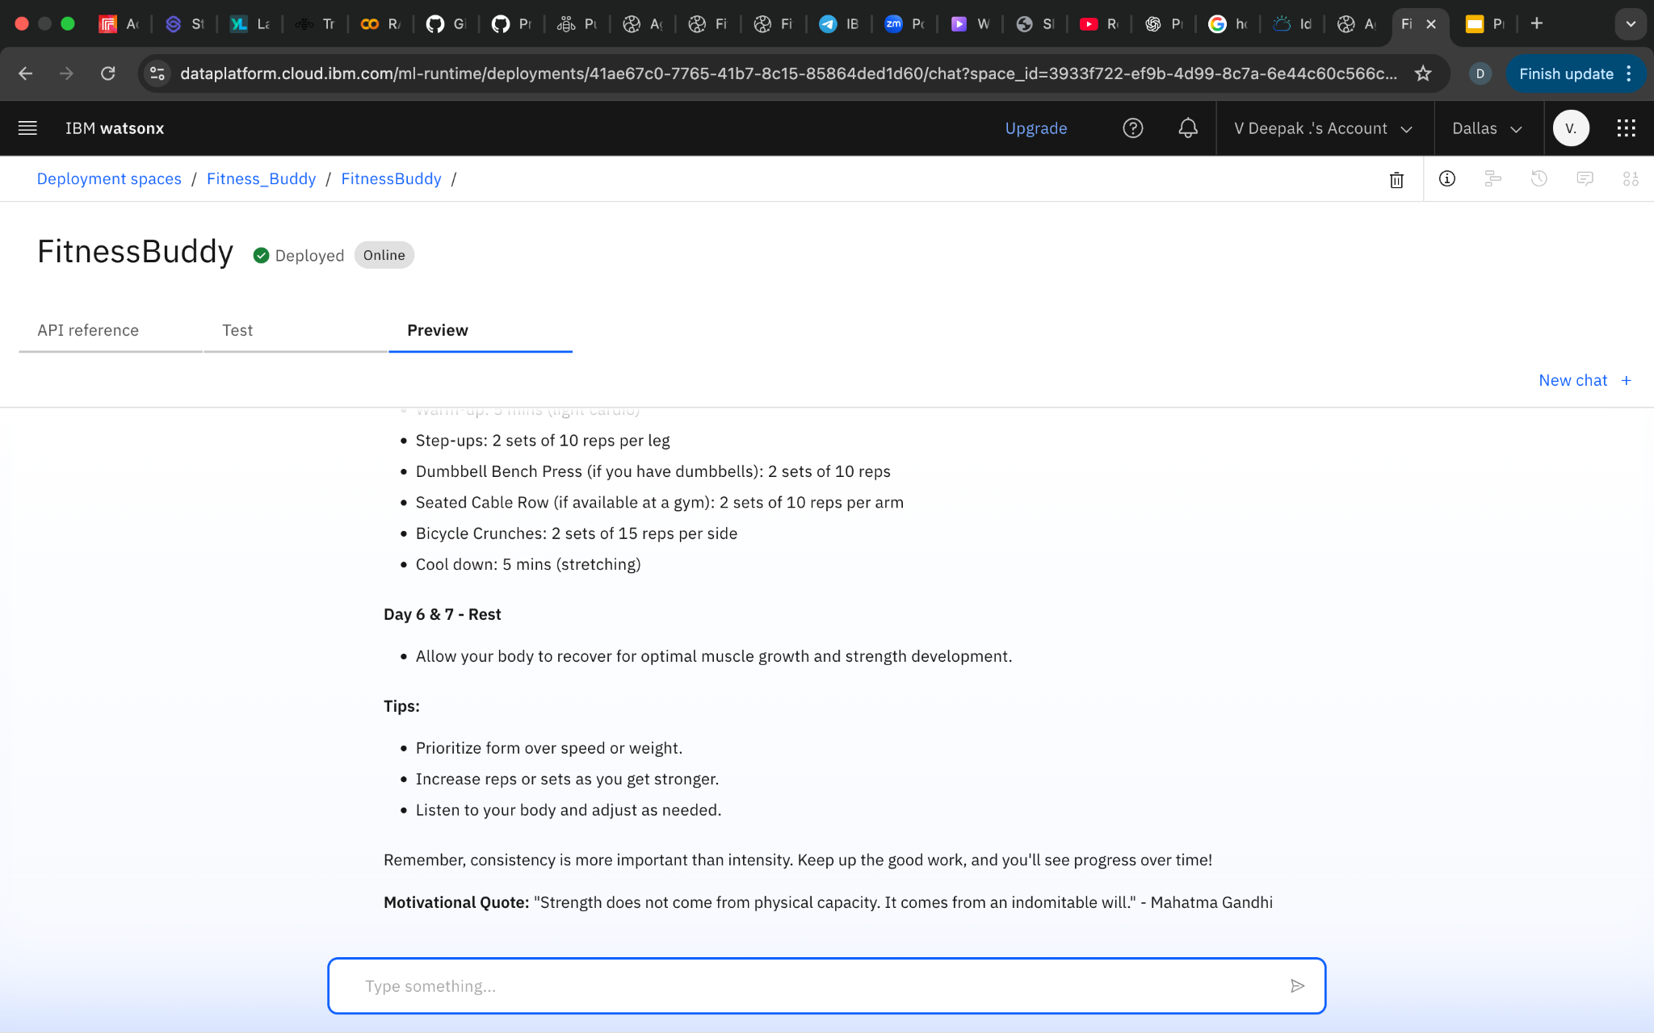
RESULTS - Deployed

Slide 10
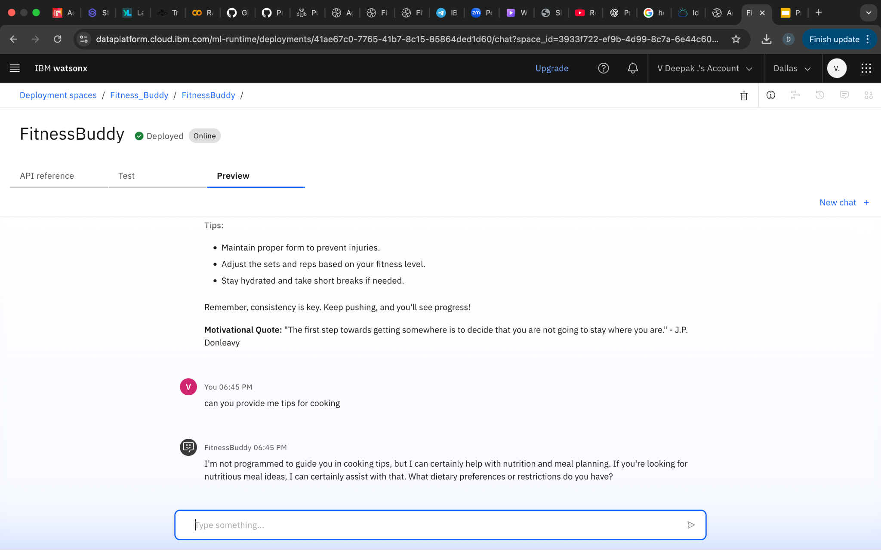
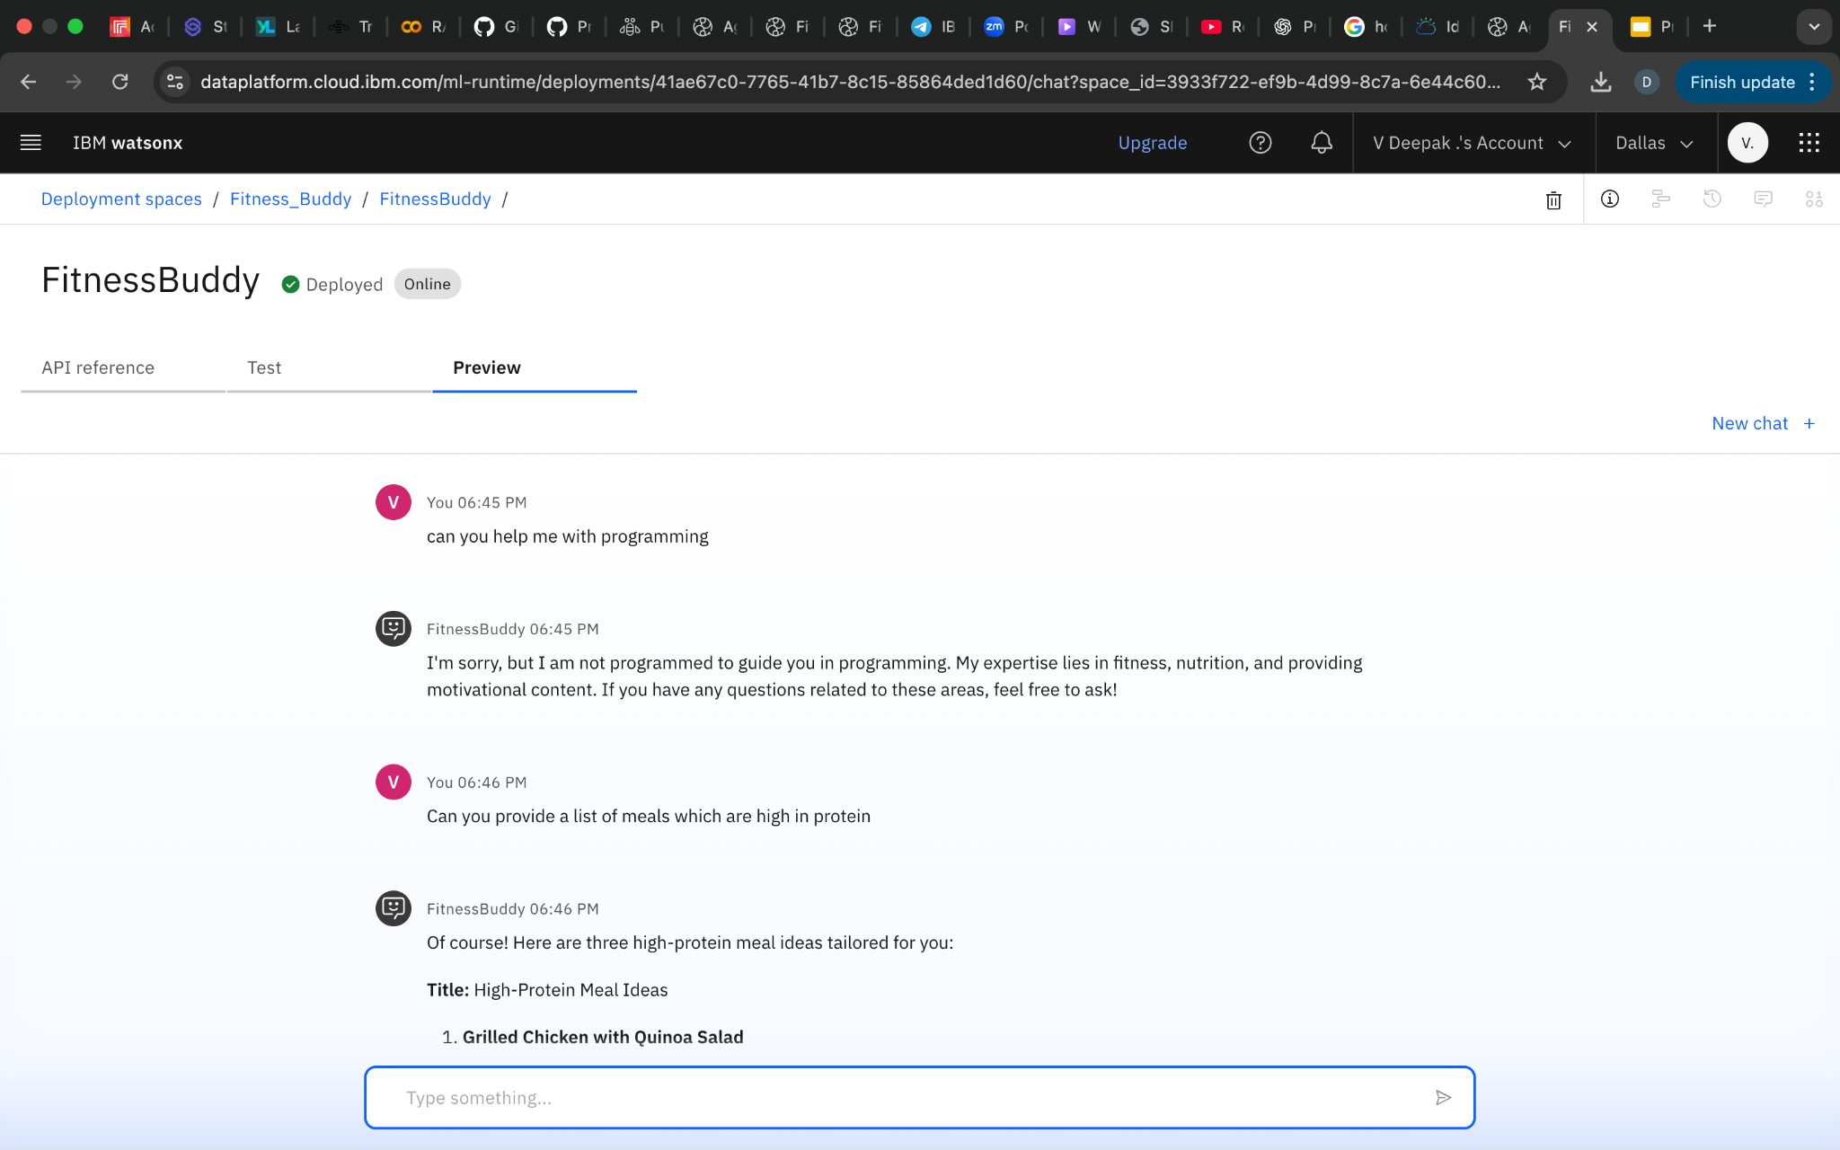

Slide 11
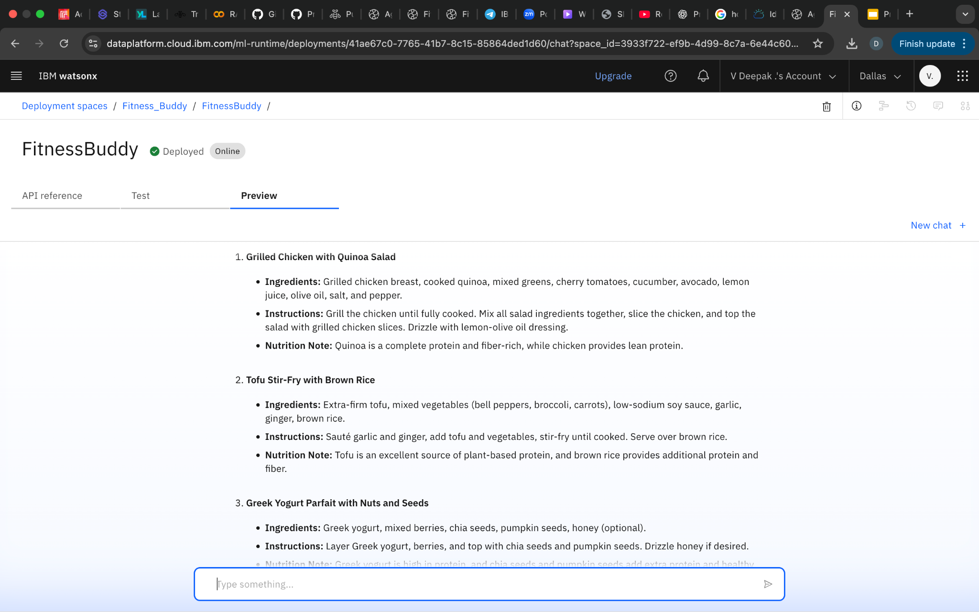
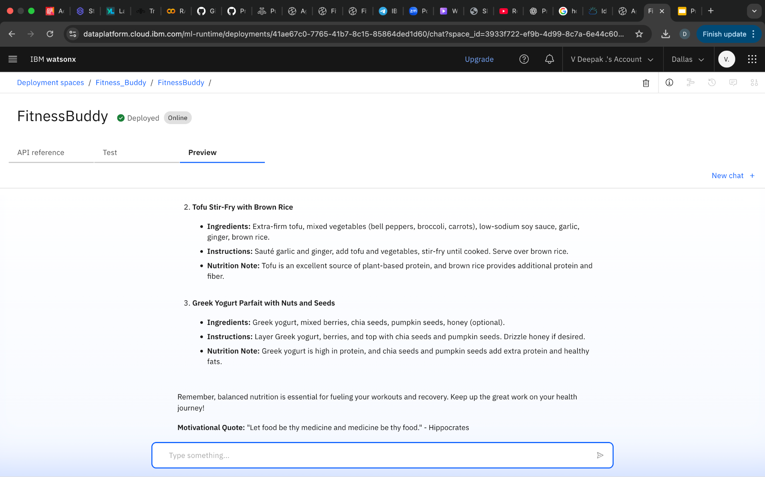
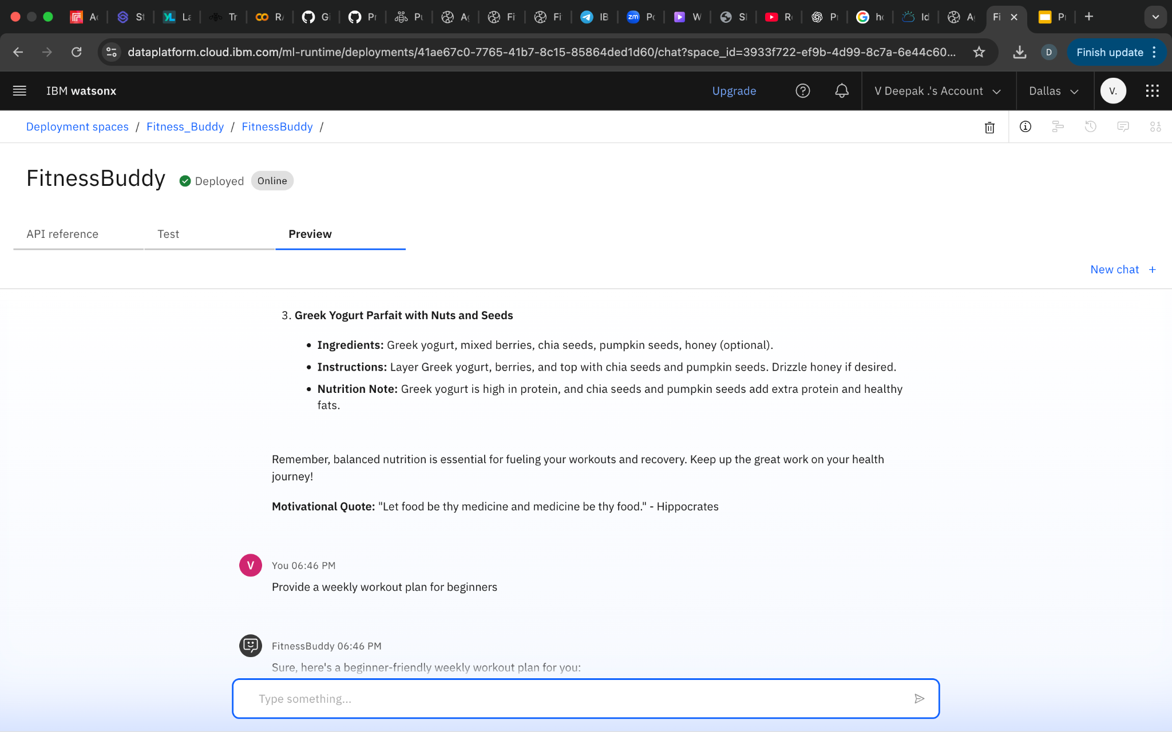
RESULTS

Slide 12
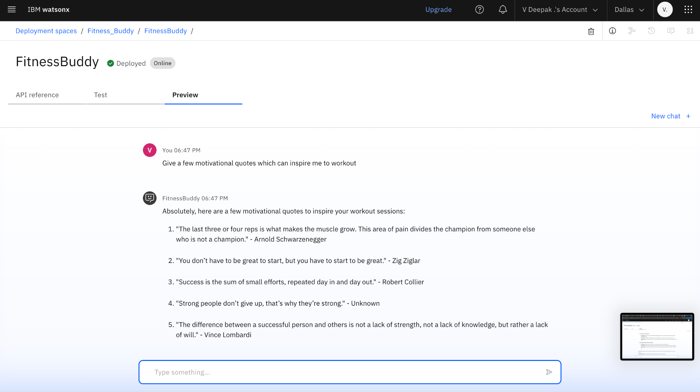
RESULTS

Slide 13
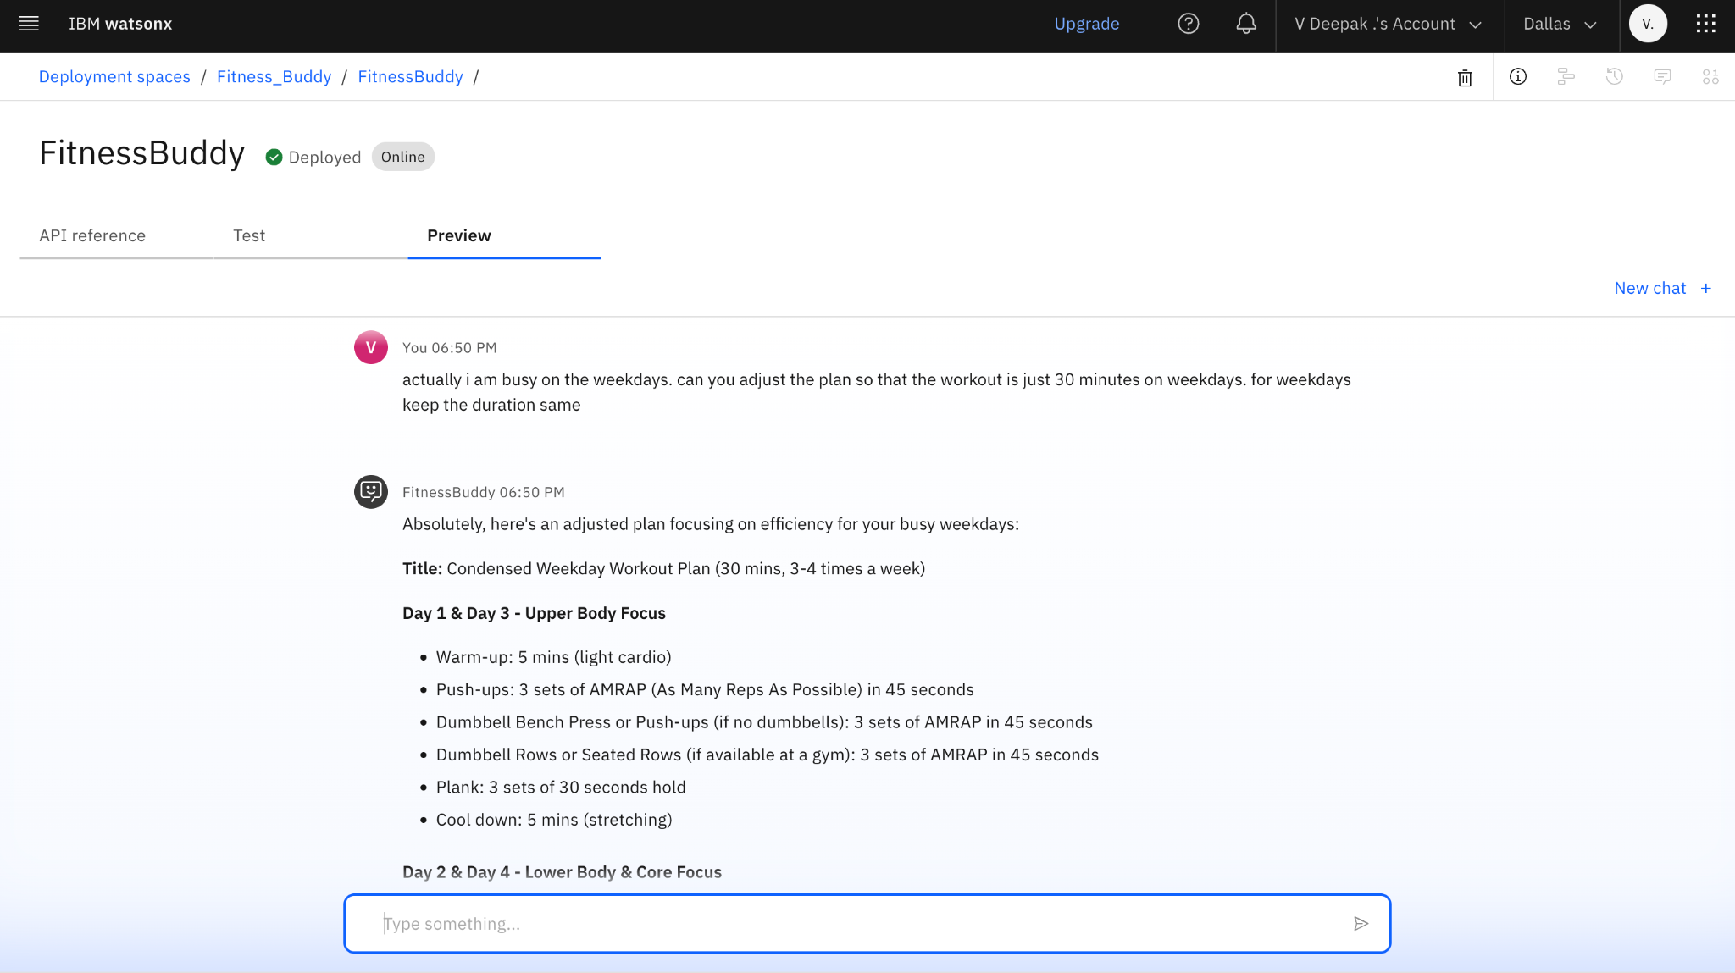
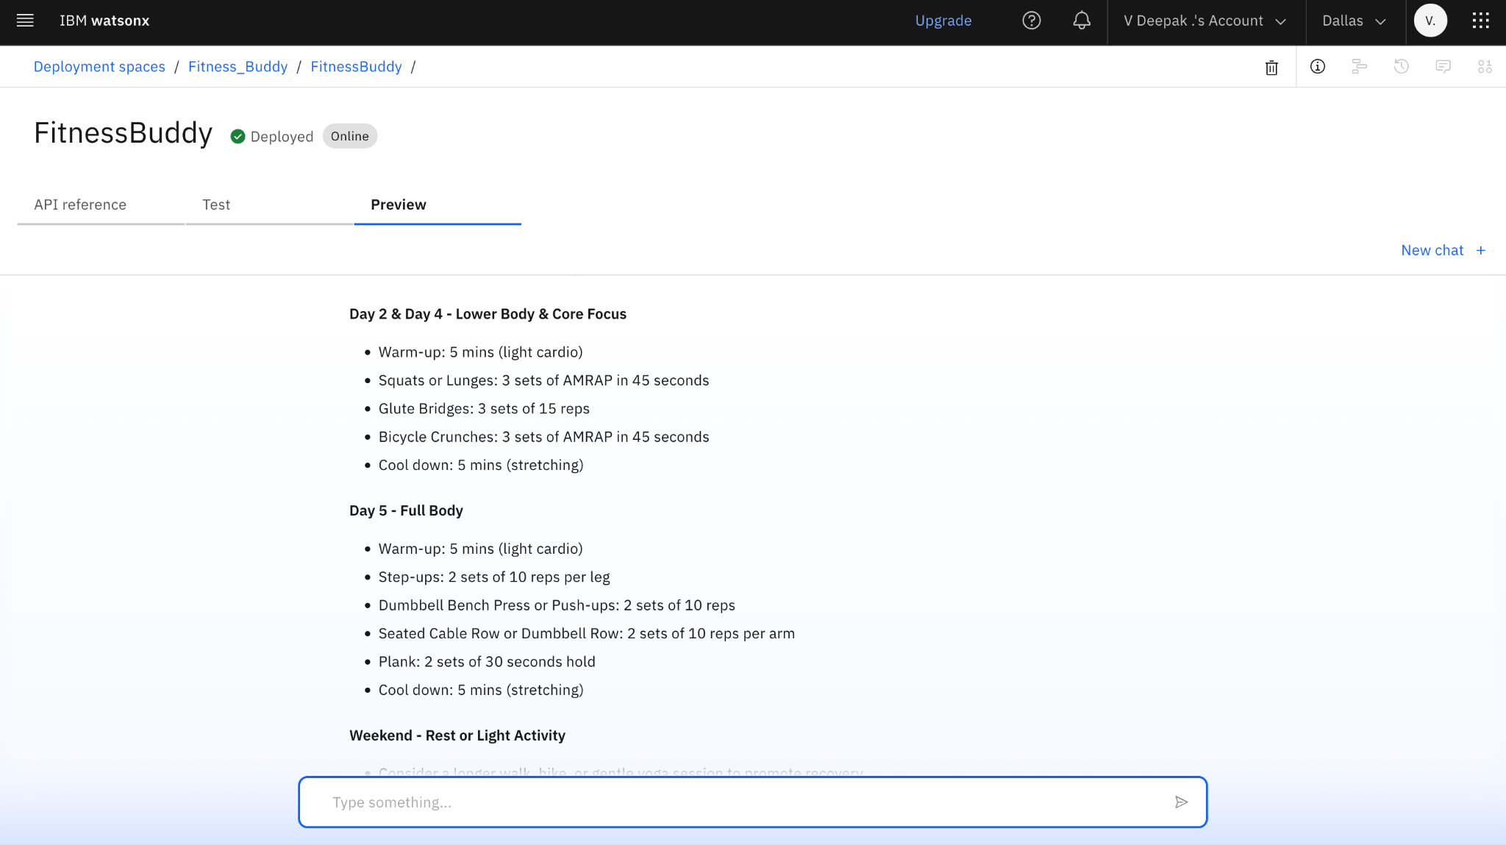
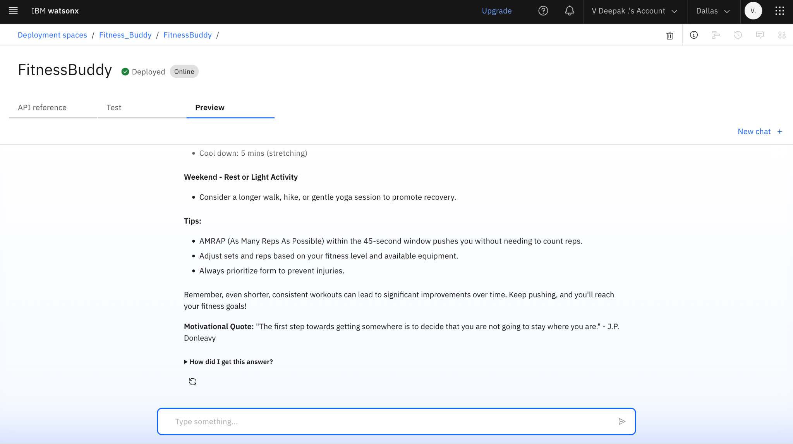
RESULTS

Slide 14
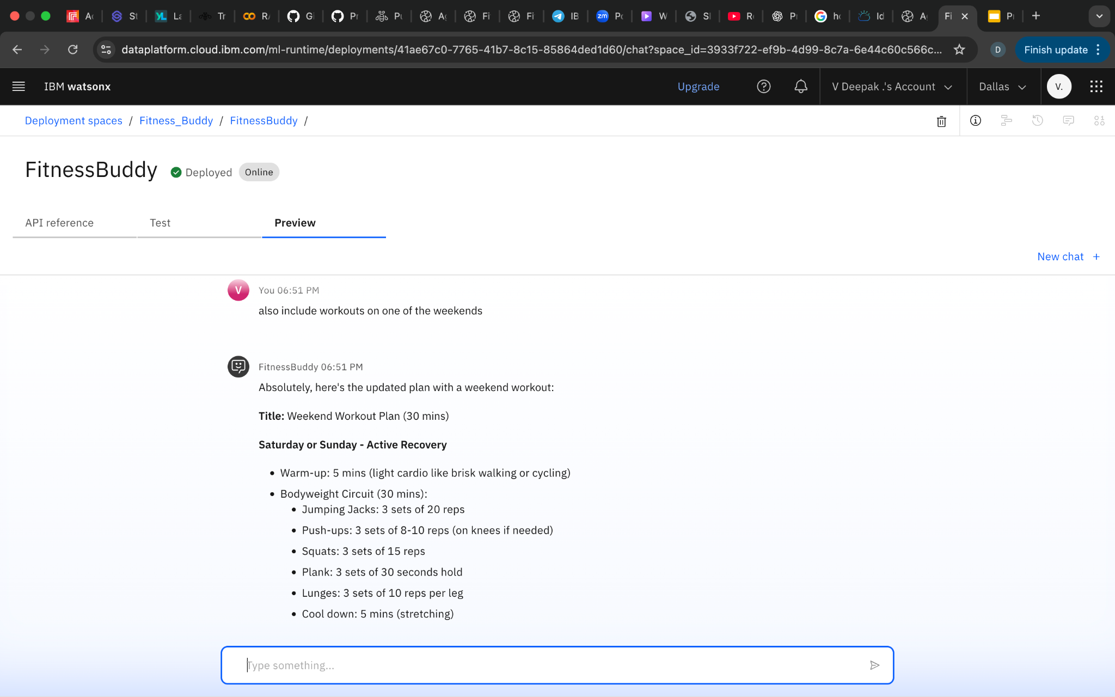
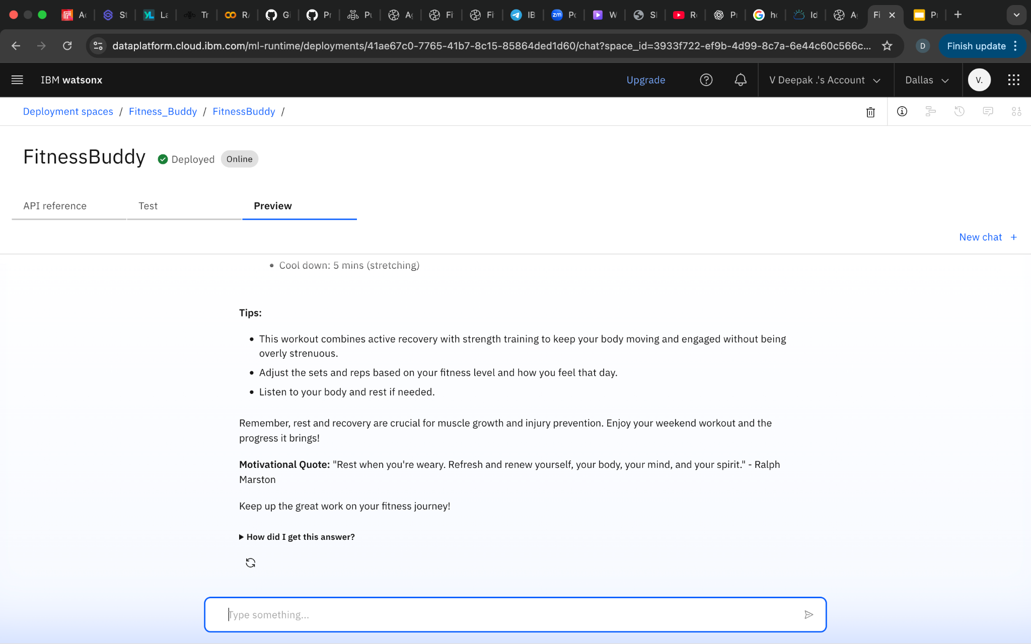

Slide 15
CONCLUSION
The AI agent simulates an intelligent fitness coach by leveraging IBM’s Granite foundation model through Watsonx.ai.
It uses prompt engineering to dynamically switch roles—trainer, nutritionist, and motivator—based on user intent.
The agent delivers context-aware, personalized responses that adapt to user goals, fitness level, and preferences.
It demonstrates the power of Agentic AI in providing real-time, on-demand wellness guidance in a conversational format.

Slide 16
FUTURE SCOPE
User Profiling and Progress Tracking
Multi-Modal Input and Output
Habit-Building and Smart Reminders
Integration with Wearables and Health Apps
Gamification for Motivation
Localized and Multilingual Support
AI Personalization Enhancements

Slide 17
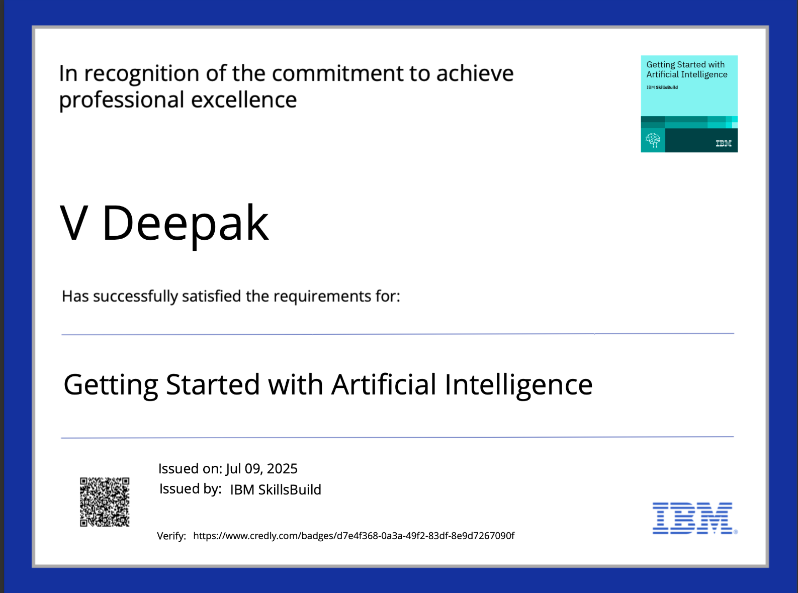
IBM CERTIFICATIONS
Getting Started with Artificial Intelligence

Slide 18
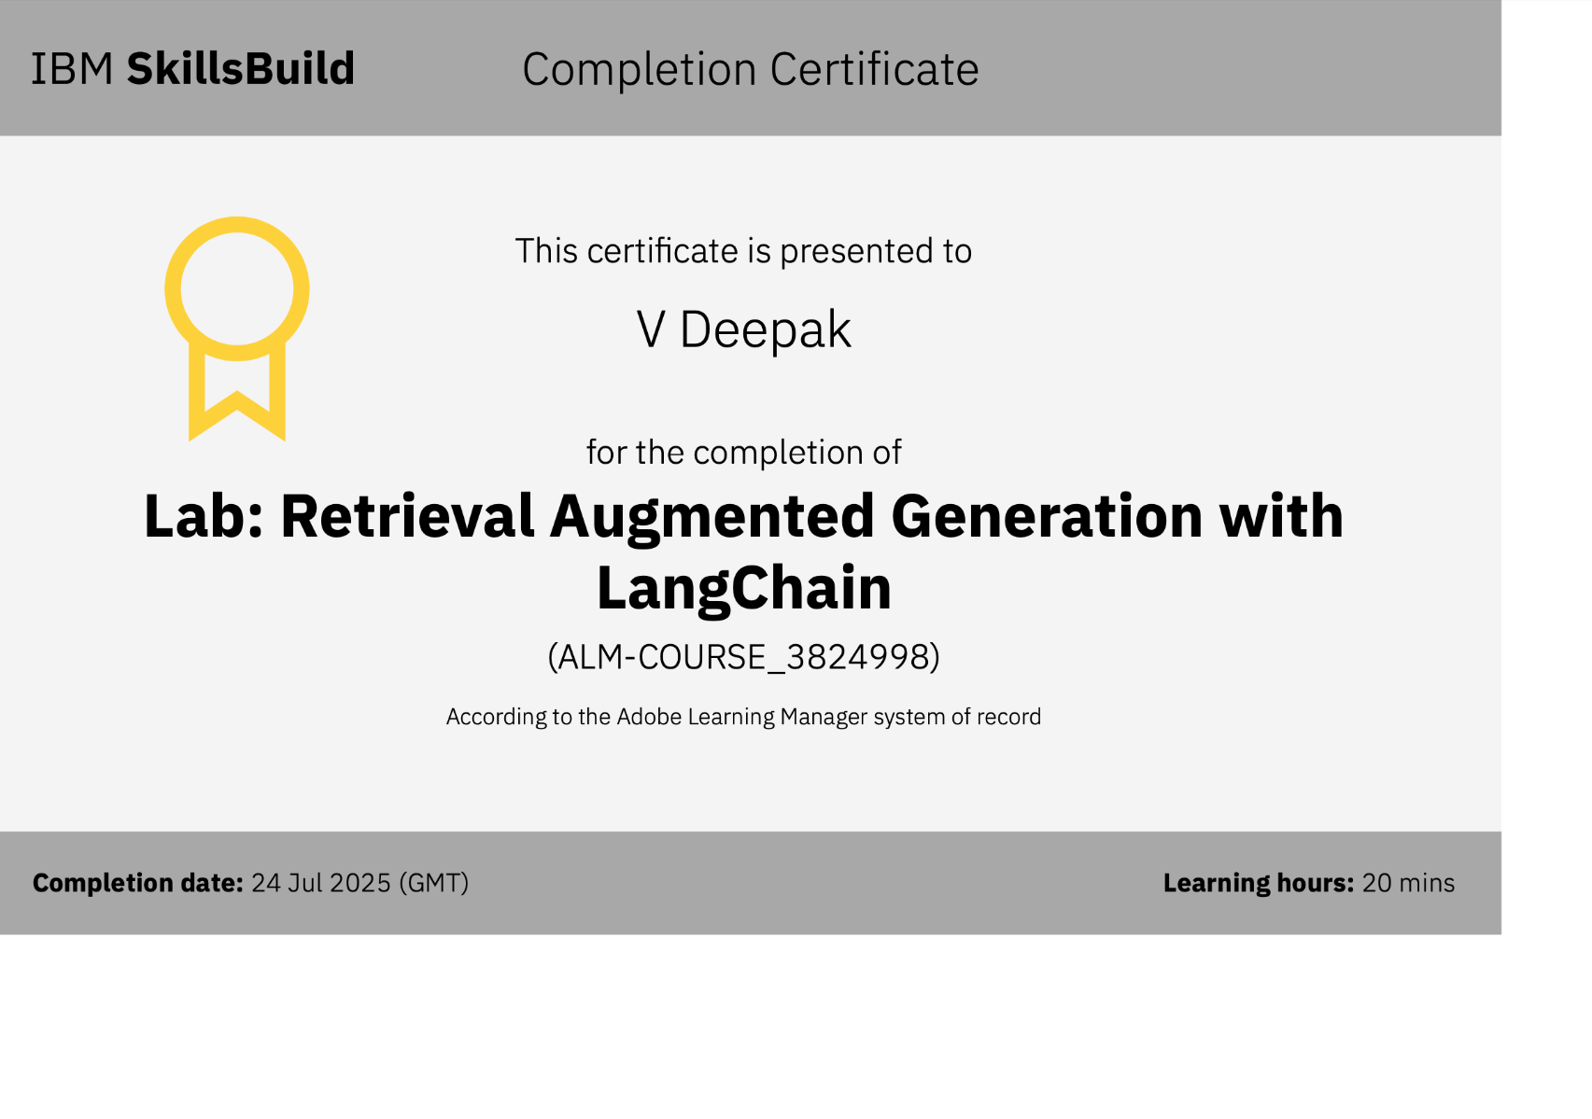
RAG Lab

Slide 19
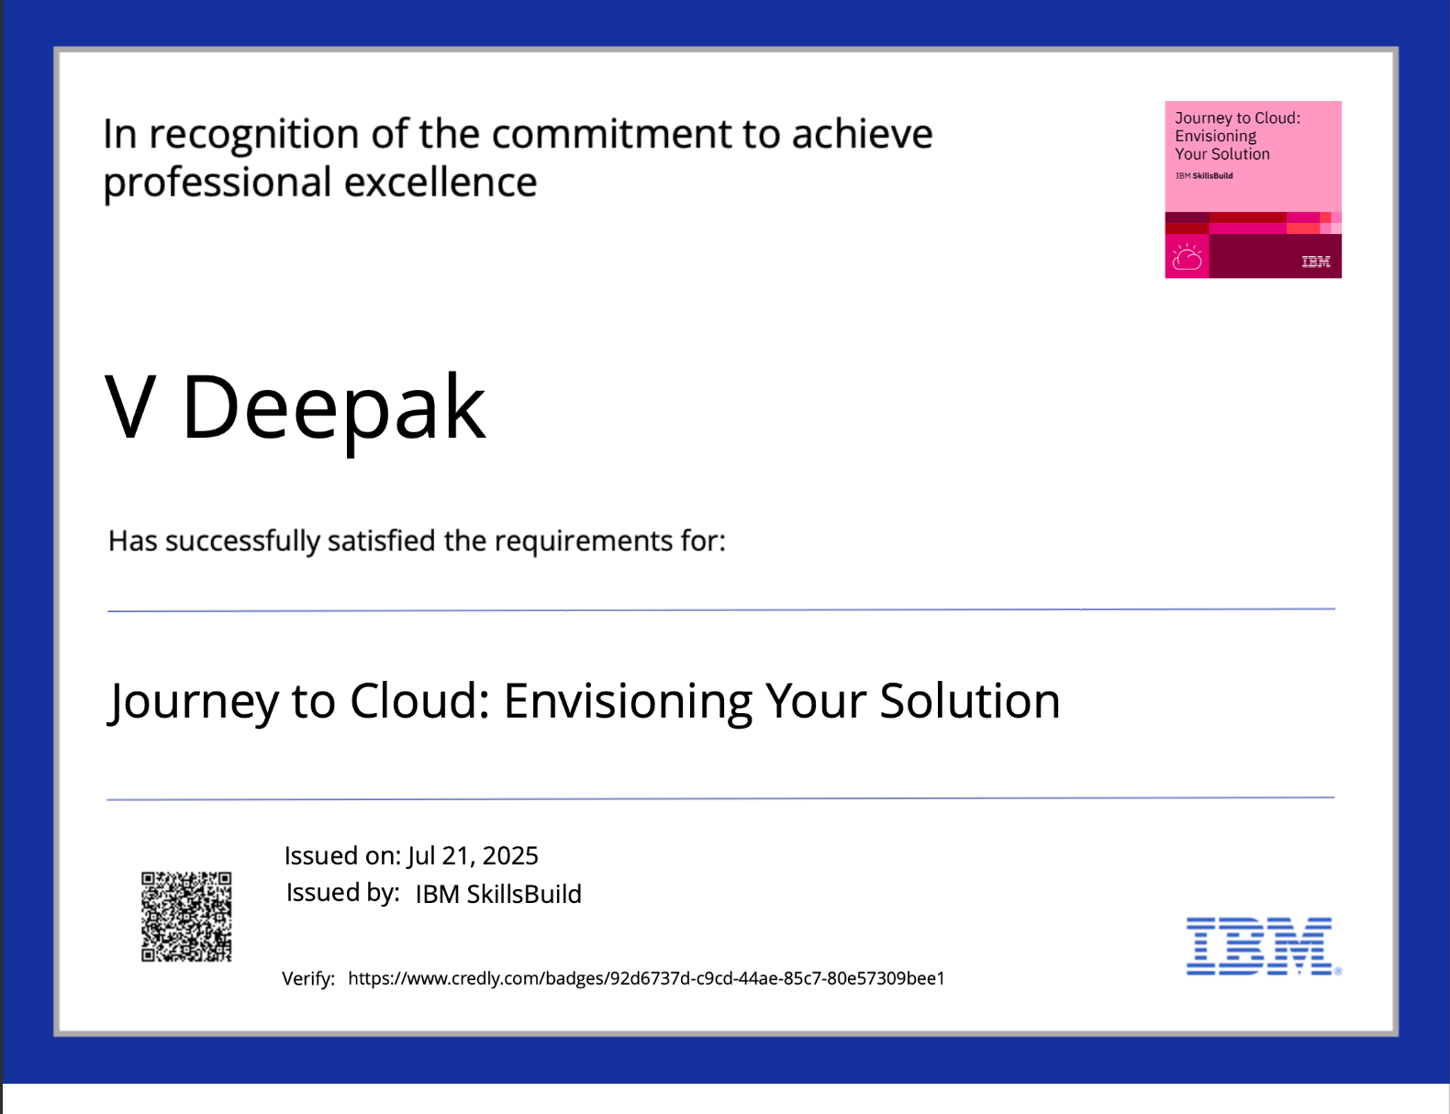
Journey to Cloud

Slide 20
GITHUB LINK
https://github.com/VDeepak05/Fitness-buddy1

Slide 21
THANK YOU

